Slide 1

A
Mini Project - II Presentation on
“Ultimate AI Companion For Smarter Home”
Presented by
Mr. Jayesh Nitin Nanekar
Mr. Aniket Ganesh Pawar
Mr. Krishna Jagdish Kulthe
Mr. Sagar Mallinath Sutarpanchal
Under the guidance of
Prof. Malayaj Kumar
Department of Computer Engineering
School of Engineering & Technology
D.Y. Patil University, Pune.
Academic Year 2023-24.

Slide 2
Presentation Outline
Introduction
Literature Survey
Proposed Block Diagram of System
Methodology(Hardware & Software)
Schematic
Flowchart /Algorithm
Simulation Results (if any)
Applications
Conclusions
Refrences

Slide 3
Introduction
Welcome to the future of living, where innovation and technology converge to Upgrade Your Everyday Life. In a world characterized by rapid technological advancements, this project represents a pioneering Android and web-based application designed to redefine the way we interact with our living spaces.
Our groundbreaking solution seamlessly integrates Home Automation and Next-Generation Artificial Intelligence (AI), offering more than just an application – it's a transformative experience.
Imagine a home where your voice commands effortlessly control various home devices, making living smarter and safer. Safety is a top priority, with advanced sensors and AI algorithms detecting and responding to potential fire hazards.
But it doesn't stop there. Our platform unifies your smart devices, whether you're at home or away, empowering you to manage them remotely through your smartphone or simple voice commands.
As the world embraces environmental sustainability, our application optimizes energy usage, manages resource consumption, and reduces your environmental impact. It's not just about convenience; it's about making a difference.
Join us on this journey of innovation, safety, and sustainability. 'Upgrade Your Everyday Life' is more than a tool; it's a catalyst for positive change, making your life easier, your home smarter, and our world greener.
Welcome to a brighter, smarter, and more sustainable future.

Slide 4
Introduction
Our Idea/Solution/Prototype:
We are looking for a solution by creating an Android & Web-based application that will serve as a platform for consumers to Upgrade their day to day life. We can accumulated HOME-AUTOMATION with new –gen AI that gives all new AI based Home-Autonomous system. The Prototype will function as follows:
⮚ Utilizes AI for voice reorganization and natural language processing (NLP). Enables user to control various Home devices and functions through voice commands
⮚ Integrates advance sensors and AI-algorithm for fire detection. Analyses the severity and area of fire in the home. Suggests actions such as evacuation routes contacting authorities and using fire fighting equipment's.
⮚ Seamlessly integrates with existing home appliances platforms. Enables remote monitoring and controls through smartphones and voice commands.
⮚ Optimizes energy usage by managing water and power consumption. Helps to reduce utility bills and environmental impacts.
⮚ In rural areas where traditional irrigation system are prevalent, AI based home automation system can be employed to retrofit this system. So farmers can remotely monitor and control the irrigation system
⮚ Uses AI and ML to monitor and analyze unusual or anonymous activities within the surrounding. Detects unauthorized access and sends alerts to customer or security services in real time.
⮚ Offers user friendly Web-app or voice interface for easy interaction. Also provides AI-bot interaction.

Slide 5
Literature Survey
S. N. | Name of Author | Title | Publication | Methodology | Drawbacks
1 | Yadnya Adhiya, Shriya Ghuge, H.D Gadade | “A survey on home automation system using IOT” | IJRITCC Volume_5_IssuesMarch_17_Volume_5_Issue_3 | Challenges of Home automation systems
2 | Basil Hamed | “Design & Implementation of Smart House Control using LabVIEW” | International Journal of Soft Computing and Engineering (IJSCE) ISSN: 2231 – 2307, Volume- 1 Issue- 6, January 2012 | The main objective of this Paper is to design and implement a control and monitor system for smart house
3 | Mehmet Mücahit KAYA Yusuf TAŞKIRAN Ada KANOĞLU | Designing a Smart Home Management System with Artificial Intelligence & Machine Learning | Designing a Smart Home Management System with Artificial Intelligence & Machine Learning | The functions of HMS can be considered in seven subgroups besides five levelled analogy: energy management, food, water, waste management, healthcare, customisation/entertainment, and security.

Slide 6
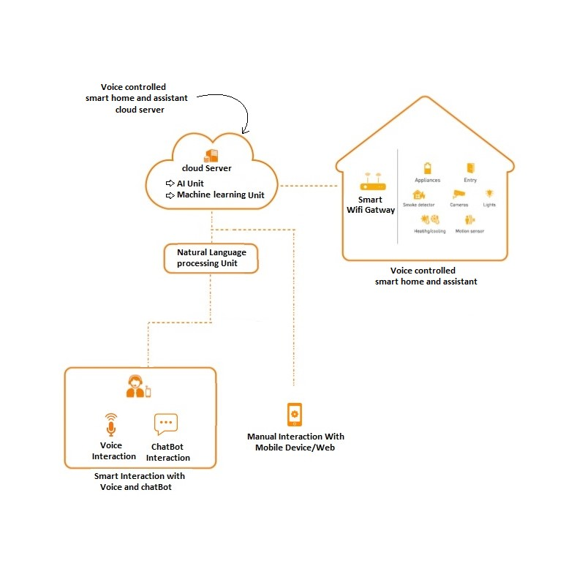
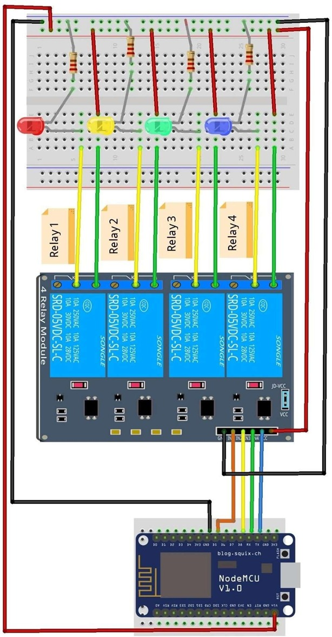
Proposed Block Diagram
Fig: Block Diagram of Proposed System

Slide 7
Methodology
AI-powered home automation refers to the use of artificial intelligence (AI) and machine learning to enhance and automate various aspects of your home, from controlling devices to improving energy efficiency and security. Here's a methodology for implementing AI in home automation:
Define Objectives:
  Start by defining your objectives and what you want to achieve with AI home automation. For example, you may want to improve energy efficiency, enhance security, or make your daily routines more convenient.
Assess Your Needs:
  Identify the specific areas or devices in your home that could benefit from automation and AI. This could include lighting, heating and cooling systems, security cameras, smart appliances, and more.
Select the Right AI Platform:
  Choose an AI platform or framework that suits your needs. Popular options include Amazon Alexa, Google Assistant, Apple Home Kit, or open-source platforms like Home Assistant. Ensure compatibility with your existing smart devices.
Smart Device Integration:
  Connect and integrate your existing smart devices with the AI platform. Ensure that your devices are compatible and can communicate with the platform effectively.
Data Collection and Analysis:
  Implement sensors and data collection devices to gather information about your home environment. This data will be used to make informed decisions. AI can analyze this data to provide insights and automation triggers.
Machine Learning Models:
  Develop or use pre-built machine learning models to analyze the data. These models can help predict user preferences, detect anomalies (e.g., security breaches or water leaks), and optimize energy usage.
Automation Rules:
  Set up automation rules based on the insights and predictions from your machine learning models. For example, you can create rules to adjust thermostat settings based on your daily routines, or to turn off lights when a room is unoccupied.
Voice and App Control:
  Configure voice commands and mobile apps to control your AI-driven home automation system. This allows you to interact with and manage your smart devices easily.

Slide 8
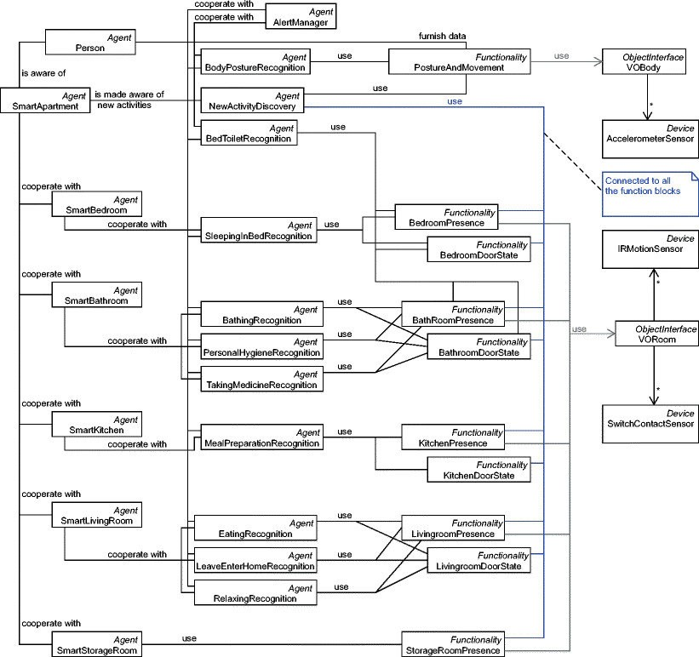
Schematic -

Slide 9
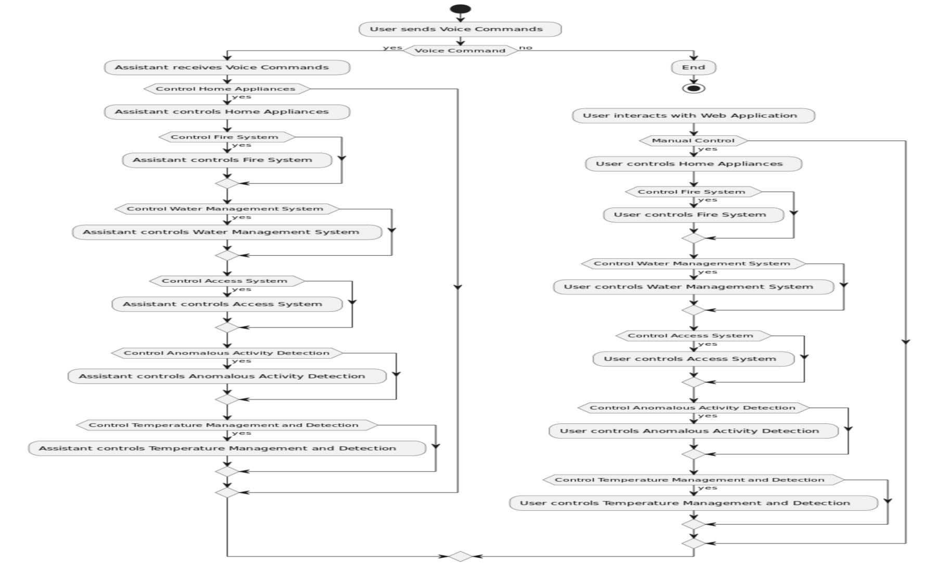
Flowchart / Algorithm

Slide 10
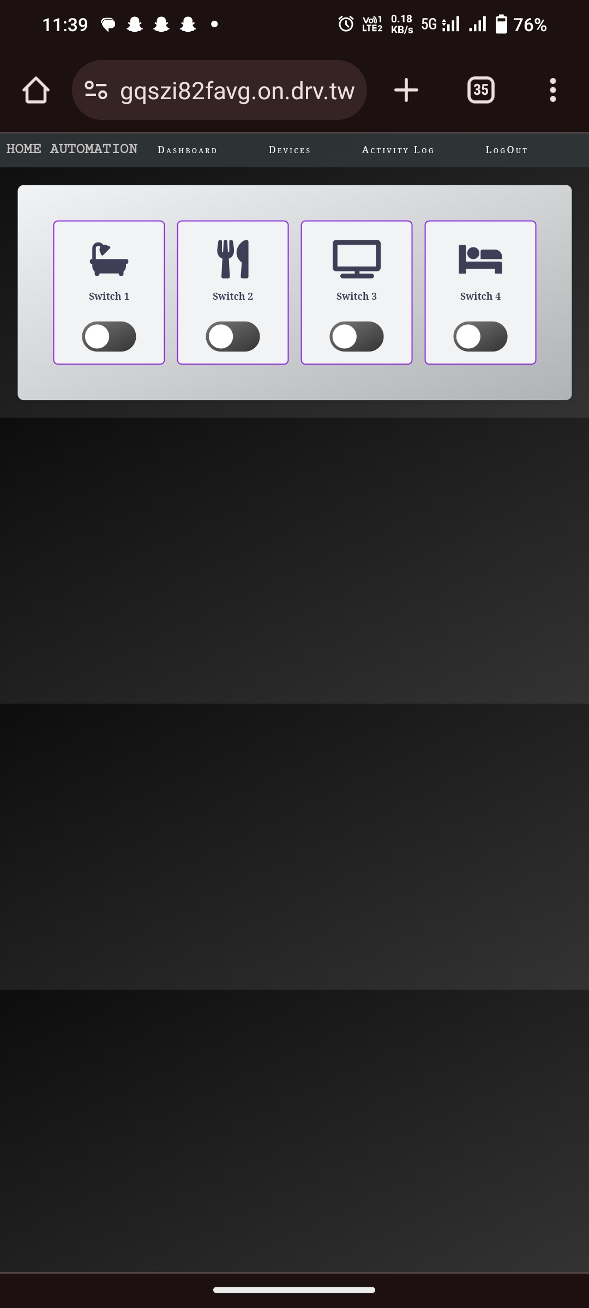
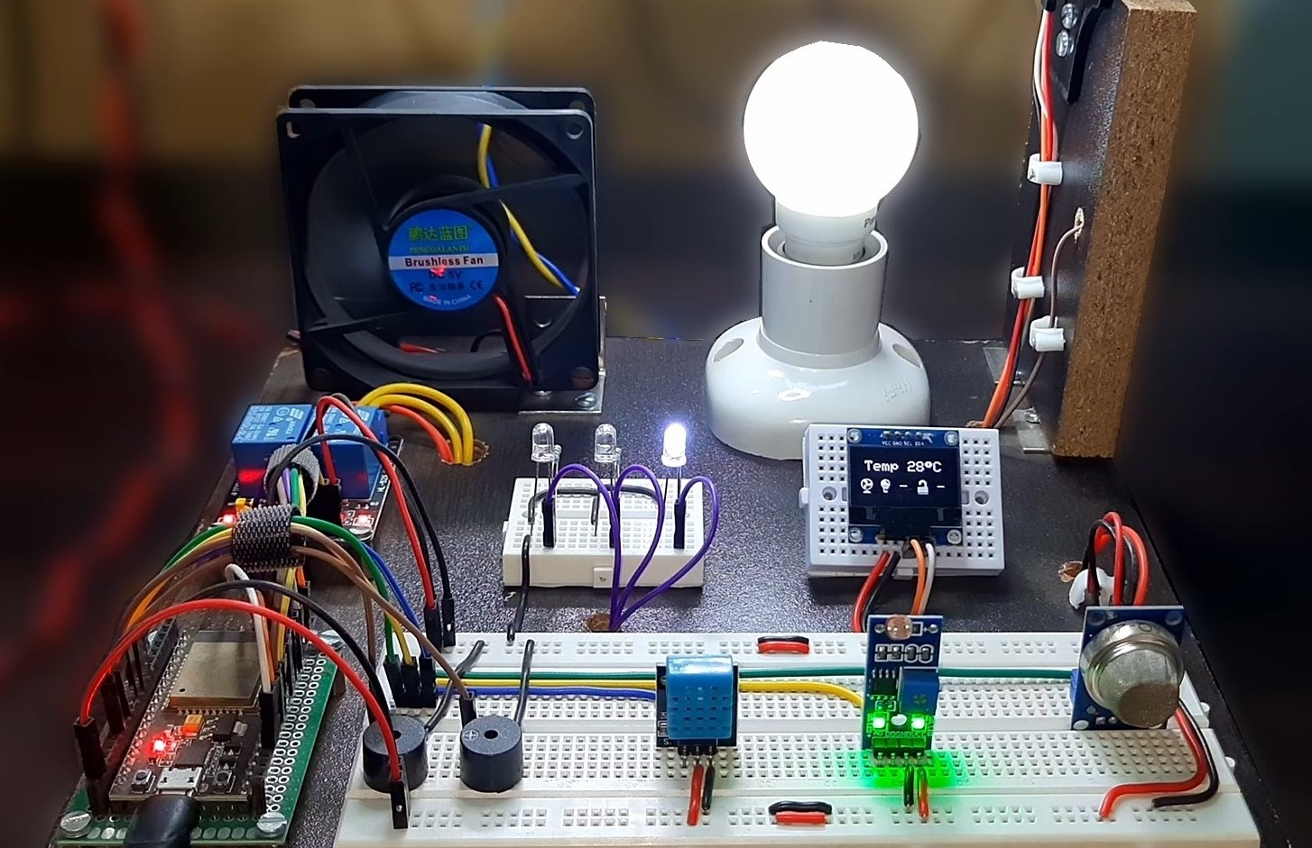
Simulation Results

Slide 11
Applications
⮚ When you are Away from your home, system can keep an eyeon your property.
⮚ Ensure the safety of your children and elderly family membersat home.
⮚ If you rent out your property, use the system monitor guest activity discreetly, allowing you to maintain property rules and security.
⮚ Be alerted to any potential dangers or emergencies without invading privacy through intrusive surveillance.
⮚ The system’s ethical responsibility to safeguard lives and property by proactively addressing fire risks while minimizing false alarms to avoid unnecessary panic or disruption.
⮚ AI based home automation system, making daily task easier for users by simply using their voice.
⮚ Our technology brings AI based smart and efficient automation technology to rural areas helping farmers to increase productivity and conserve valuable resources. Also provides a new aged technology on their fingertip

Slide 12
Conclusions
In closing, 'Upgrade Your Everyday Life' represents not just a vision, but a tangible reality—a future where technology, safety, and sustainability converge to redefine our lives and our homes.
Through this innovative Android and web-based application, we've harnessed the power of AI to make homes more intuitive, responsive, and secure. Your voice commands transform into actions, from controlling devices to ensuring your safety.
Our commitment extends beyond convenience. With advanced sensors and AI algorithms, we've prioritized your safety, offering actionable recommendations during emergencies. Moreover, we've seamlessly integrated with your existing smart devices, giving you unparalleled control, whether you're home or away.
In an era when environmental sustainability is paramount, we optimize energy usage and manage resources to reduce your environmental footprint. Every step you take with us is a step towards a greener world.
We invite you to join us on this journey of innovation, safety, and sustainability. 'Upgrade Your Everyday Life' is not just an application; it's a catalyst for positive change.
Welcome to the future of living—where your life is easier, your home is smarter, and our world is greener.

Slide 13
Refrences
[1] Yadnya Adhiya, Shriya Ghuge, H.D Gadade “A survey on home automation system using IOT” IJRITCC Volume_5_IssuesMarch_17_Volume_5_Issue_3
[2] Kim Baraka, Marc Ghobril, Sami Malek, RouwaidaKanj, Ayman Kayssi “Low cost Arduino/Android-based Energy-Efficient Home Automation System with Smart Task Scheduling”, 2013 Fifth International Conference on Computational Intelligence, Communication Systems and Networks.
[3] HayetLamine and HafedhAbid,” Remote control of a domestic equipment from an Android application based on Raspberry pi card”, IEEE transaction 15th international conference on Sciences and Techniques of Automatic control & computer engineering - STA'2014, Hammamet, Tunisia, December 21-23, 2014.
[4] YunCui, MyoungjinKim, YiGu, Jong-jinJung, and HankuLee, “Home Appliance Management System for Monitoring Digitized Devices Using Cloud Computing Technology in Ubiquitous Sensor Network Environment”,Hindawi Publishing Corporation International Journal of Distributed Sensor Networks Volume 2014, Article ID 174097
[5] Shih-Pang Tseng, Bo-Rong Li, Jun-Long Pan, and ChiaJuLin,”An Application of Internet of Things with Motion Sensing on Smart House“, 978-1-4799-6284-6/14 c ⃝2014 IEEE.
[6] Kim Baraka, Marc Ghobril, Sami Malek, RouwaidaKanj, Ayman Kayssi,” Smart Power Management System For Home Appliances And Wellness Based On Wireless Sensors Network And Mobile Technology”, ,2015 XVIII AISEM Annual Conference, 978-1-4799-8591-3/15©2015 IEEE
[7] Shiu Kumar,” UBIQUITOUS SMART HOME SYSTEM USING ANDROID APPLICATION “, International Journal of Computer Networks & Communications (IJCNC) Vol.6, No.1, January 2014.
[8] Jan Gebhardt, Michael Massoth, Stefan Weber and TorstenWiens, “Ubiquitous Smart Home Controlling Raspberry Embedded System”, UBICOMM: The Eighth International Conference on Mobile Ubiquitous Computing, Systems, Services and Technologies, 2014.

Slide 14
Thank you!

